Slide 1
LossRadar: Fast Detection of Lost Packets in Data Centers
Yuliang Li
Rui Miao Changhoon Kim Minlan Yu

Slide 2
Problems:
Hard to locate
Not generic
Large overhead
Unknown root cause
Time consuming
I fail to connect!
Where?
Me too!
Congestion?
Blackhole?
Random drops?
Why?

Slide 3
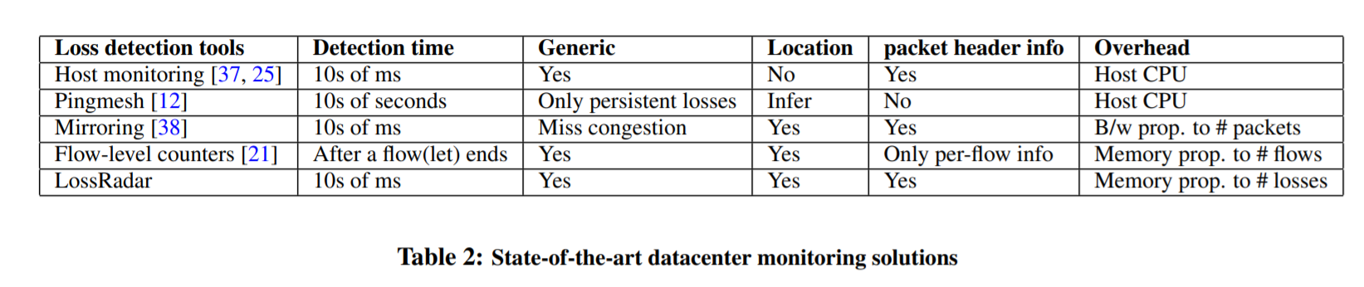
End host based solutions
准确定位丢包位置困难.
Pingmesh
可以推断丢包位置，但是不能与应用关联，不能区分丢包原因，并且probe的频率太低. (007发表于这片文章之后，已经能够定位link，与应用关联，但是不能区分丢包原因)
Mirroring
EverFlow：漏掉丢包类型和数量、开销大
Counters at switches:
SNMP 因为丢包原因多种并且不确定，很难提前配置好对应的counter.
FlowRadar（NSDI 2016）使用per-flow的counter，但是需要多交换机的counter对比同步才能知道丢包，并且存储消耗与monitor的流数目成正比.

Slide 4
LossRadar overview
Knowing location → Install meters to monitor traffic
Fast detection → Frequently send traffic digest to collector
Being generic → Compare packets across hops
Need info of individual losses → Include details of each loss
Low overhead ?
Digest Collector
Traffic Digest
Traffic Digest
Traffic Digest

Slide 5
Invertible Bloom Filter: multiple hashes
a
a = <5-tuple, IP_Identification >
H1
H2
H3
xorSum count
[Invertible Bloom Filter (Sigcomm’ 11)]

Slide 6
Invertible Bloom Filter: multiple hashes
a
a = <5-tuple, IP_Identification >
H1
H2
H3
xorSum count | a 1 |  | a 1 | a 1
[Invertible Bloom Filter (Sigcomm’ 11)]

Slide 7
Invertible Bloom Filter: mix packets with XOR
b
H1
H2
H3
xorSum count | a 1 |  | a 1 | a 1
[Invertible Bloom Filter (Sigcomm’ 11)]

Slide 8
Invertible Bloom Filter: mix packets with XOR
b
H1
H2
H3
xorSum count | a 1 | b 1 | a⊕b 2 | a 1 | b 2
[Invertible Bloom Filter (Sigcomm’ 11)]

Slide 9
Same hash functions across switches
upstream
xorSum count | 0 0 | 0 0 | 0 0 | 0 0 | 0 0
downstream
xorSum count | 0 0 | 0 0 | 0 0 | 0 0 | 0 0
Collector
[Invertible Bloom Filter (Sigcomm’ 11)]

Slide 10
Same hash functions across switches
a
a
a
upstream
xorSum count | a 1 | 0 0 | a 1 | a 1 | 0 0
a
drop
downstream
xorSum count | 0 0 | 0 0 | 0 0 | 0 0 | 0 0
Collector
[Invertible Bloom Filter (Sigcomm’ 11)]

Slide 11
Same hash functions across switches
b
a
b
a
a
b
upstream
xorSum count | a 1 | b 1 | a⊕b 2 | a 1 | b 1
b
b
b
b
downstream
xorSum count | 0 0 | b 1 | b 1 | 0 0 | b 1
b
Collector
[Invertible Bloom Filter (Sigcomm’ 11)]

Slide 12
Same hash functions across switches
c
c
b
c
a
b
a
a
b
upstream
xorSum count | a⊕c 2 | b⊕c 2 | a⊕b 2 | a⊕c 2 | b 1
c
drop
b
b
b
downstream
xorSum count | 0 0 | b 1 | b 1 | 0 0 | b 1
Collector
[Invertible Bloom Filter (Sigcomm’ 11)]

Slide 13
Same hash functions across switches
d
d
c
c
b
c
d
a
b
a
a
b
upstream
xorSum count | a⊕c⊕d 3 | b⊕c 2 | a⊕b⊕d 3 | a⊕c 2 | b⊕d 2
d
Collector does
subtraction
d
d
d
b
b
b
downstream
xorSum count | d 1 | b 1 | b⊕d 2 | 0 0 | b⊕d 2
d
c
c
a
c
a
a
Collector
xorSum count | a⊕c 2 | c 1 | a 1 | a⊕c 2 | 0 0
[Invertible Bloom Filter (Sigcomm’ 11)]

Slide 14
Retrieve losses
c
c
a
c
a
a
Collector
xorSum count | a⊕c 2 | c 1 | a 1 | a⊕c 2 | 0 0

Slide 15
Retrieve losses
Loss:
c
c
c
a
c
a
a
Collector
xorSum count | a⊕c 2 | c 1 | a 1 | a⊕c 2 | 0 0
-1
-1
-1
Existing works have shown that ncell only needs to be
proportional to nloss (i.e., c = ncell/nloss is a constant) to achieve a high success rate for decoding all losses
it shows empirically that c = 1.3 to achieve a 99% success rate when nloss > 1000 for k = 3.
[Invertible Bloom Filter (Sigcomm’ 11)]

Slide 16
Retrieve losses
Loss:
c
a
a
a
a
Collector
xorSum count | a 1 | 0 0 | a 1 | a 1 | 0 0
-1
-1
-1
Only need O(#loss) memory

Slide 17
Benefits
Memory-efficient
n_cell only needs to be proportional to n_loss (i.e., c = n_cell/n_loss is a constant) to achieve a high success rate for decoding all losses
Report a batch of packets every 10 ms
~10Mbps for 10Gbps traffic (including incast, blackhole and random drops)
Extend to collect more packet information
TTL: help identify loops
Timestamp
Any other fields that programmable switches can configure
Easy to implement in P4
Notes:
Recent programmable switches can export
information of which packets they decide to drop because of
access control lists or buffer overflow (e.g., using negative
mirroring, which is presented at P4 workshop). With these
techniques, we can also exclude the lost packets known by
switches, and thus focus LOSSRADAR digests on those losses
the switches cannot diagnose.

Slide 18
Loss Information
Flow-level information
5-tuple: 104 bits
Packet identifier
IP_ID field: 16 bits
TCP flags
TCP-SYN: 1 bit
TTL: 1 bit
Microsecond-level timestamp
14 bits for microsecond-level timestamp in 10 ms (2^14us>10ms).

Slide 19
Challenge: batch alignment
Ideally
In fact
upstream
T + timeout
downstream

Slide 20
Solution: packets carry batch ID
Just need 1 bit to distinguish adjacent batches
T
upstream
0
0
0
0
1
1
T + timeout
downstream
0
0
0
1
1
Per hop delay< 1ms
Timeout < T
so for T > 1ms, there will be at most two batches coexist at a downstream meter.

Slide 21
Solution: pair-wise deployment
UM: Upstream meter
DM: Downstream meter
Cover all pipelines
Cover ingress pipeline
Cover egress pipeline
Ingress pipeline
UM
DM
shared
buffer
Egress pipeline
DM
UM
UM
DM
DM
UM
DM
UM
DM
UM
Notes:
First, at the place where upstream meters are installed, the decision of which output port(s) a packet goes to need to have been made, so that the switch knows which upstream meter (output port) to insert the packet into.
Second, the timestamp collected at this stage is the closest to the time a packet is enqueued

Slide 22
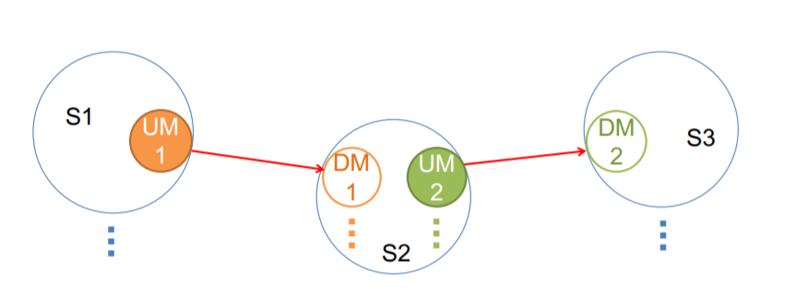
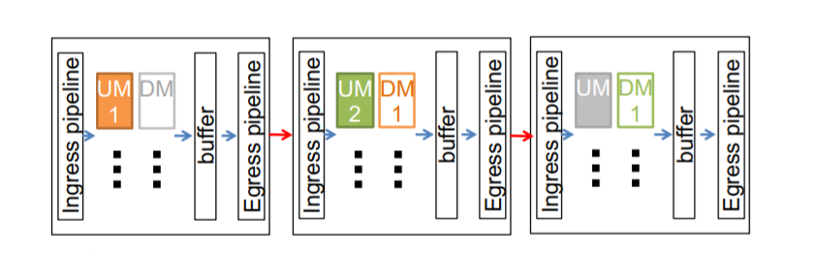
Solution: pair-wise deployment

Slide 23
Challenge: incremental deployment
Compare sum(UM_{i}) and sum(DM_{i}) Strawman approach.
the total number of losses could be n times of the number of lost packets from a single upstream meter. Thus, the size of the sum digest has to be n times of the normal size
LossRadar
LossRadar
UM
UM
Blackbox
DM
DM
UM
UM
DM
DM
LossRadar
LossRadar

Slide 24
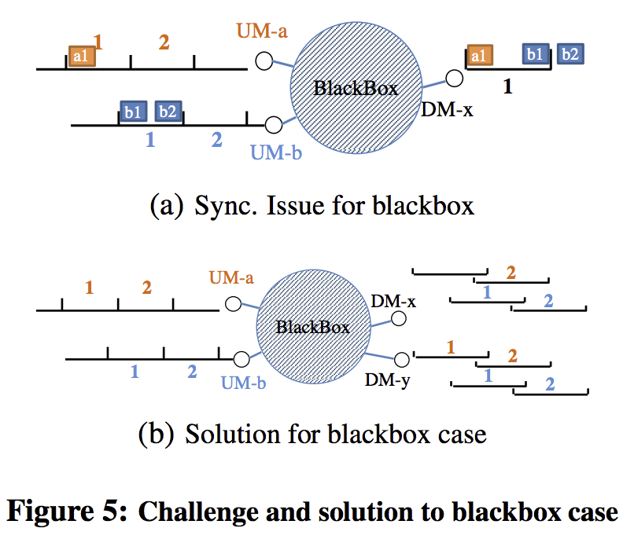
Challenge: incremental deployment
Unsynchronized clock
each upstream meter mark its meter ID in the packet header
identify all the lost packets between one upstream meter and all its downstream meters
for each upstream meter, the total size is only normal size, which is reduced by n times.
2n -> (n+1)

Slide 25
Root cause inference
Different root causes have different loss patterns
Temporal: how the losses distribute over time
Inter-flow: specific set of flows? All flows?
Intra-flow: which packets of a flow?
Congestion
Blackhole
Random drop
Dst IP = 10.0.0.0/24

Slide 26
Root cause inference
Congestion
Bursty
Blackhole
Bursty and consecutive losses within a flow (large flow)
Non-bursty and consecutive losses within a flow(small flow)
Only a SYN packet loss from each flow
Random drops
The random drops are evenly distributed over time
Loop
Packets dropped by loops have TTL = 0
Notes:
For 10G link, the transmission time of a 1500B packet is 1.2us. Thus, even if the total receiving rate is only 10% higher than the sending rate of an output port, there will be one loss every 11 packets, which is one loss every 13.2us.

Slide 27
pre-filtered
N
Y
Expected loss
TTL=0
Y
N
Loop
Burst
Loss>nburst t< tgap
N
Y
Packet
consecutive
Packet
consecutive
Y
N
Y
N
loss> nnb
N
syn>p_syn
loss> nbb
Congestion
Y
N
Y
Y
N
Blackhole
Blackhole
Random distribution
Congestion
Blackhole
Y
N
random
UNK
Notes:
If the switch does not support pre-filtering, the
collector can easily identify this kind of losses by matching
the lost packets against the table rules. We also exclude
losses with TTL = 0, which could be dropped by loops, or are
expected by the applications (e.g., traceroute). We can map
the 5-tuple of the lost packets to the application to decide if
the loss is expected or not.

Slide 28
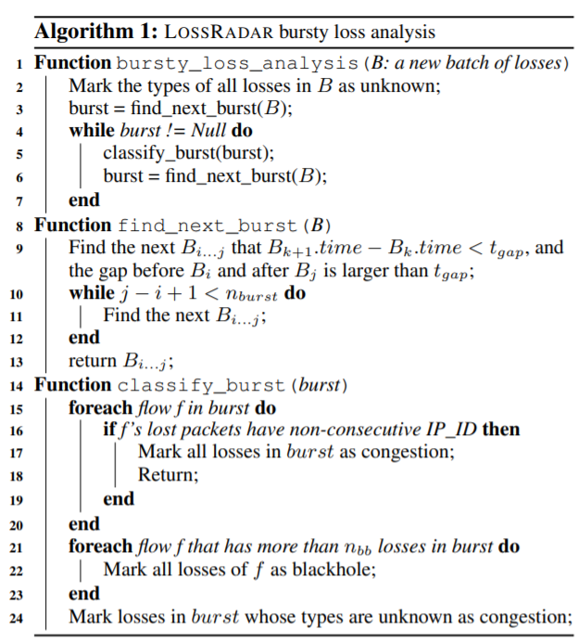
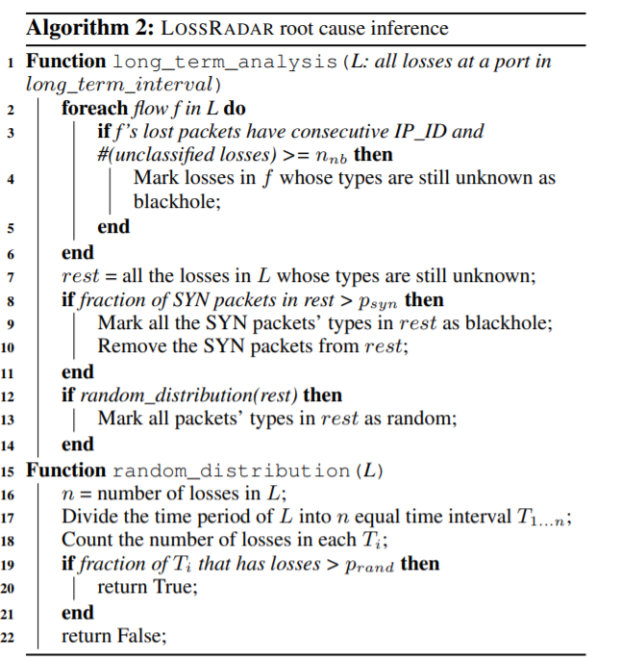
Notes:
if the fraction of SYN packets in an interval is large (> psyn)
We divide the time interval into n (number of losses)
equal bins, and count the fraction of non-empty bins (bins
with at least one loss) in all bins.

Slide 29
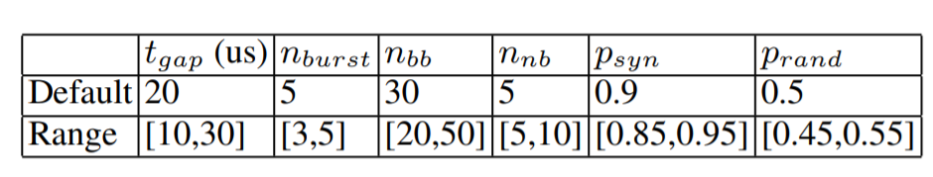
Implementation
T_gap：太大容易把随机丢包识别成拥塞,太小不容易识别轻微拥塞
N_burst: 太大不容易识别轻微拥塞，太小容易把随机丢包识别成拥塞
n_bb: 不能太小，太小容易把拥塞中IP_ID连续的情况给识别为blackhole
n_burst < n_bb
For 10G link, the transmission time of a 1500B packet is 1.2us.
Notes:
检测短暂的拥塞需要把t_gap设置地大一些，n_burst设置得小一些
T_gap也不能太大，太大容易把随机丢包给识别成拥塞
nbb should be set slightly lower than the bandwidth-delay product for flows with still-growing windows, while large enough to keep the probability of congestion dropping nbb consecutive packets of a flow low.

Slide 30
P4 Implementation
Storing traffic digests.
The i-th cell in the b-th batch of the p-th port is indexed by i + (b · nport + p) · ncell.
Updating digests.
The DM uses TTL+1 instead of TTL to cancel out the decrement between hops.
Getting timestamps.
the closest to our need is the timestamp when the switch starts processing the packet (ingress_global_timestamp).
Pre-filtering.
pre-filter the table-dropped packets by inserting them into only the DM (not the UM). (drop mark)
Header modification
We either store these data in unused header fields (e.g. VLAN, DSCP) or add a header
Notes:
Table drop只插入到DM这样上一跳的UM-DM 就把Table drop的给消掉了，不会影响非table drop数据包的decode
计算下一跳的UM需要下一跳的bacth_ID下一跳的bacth_id先存到一个数据结构中 (lr_tmp.this_batch
)
计算下一跳的DM需要上一跳的batch_ID (lossradar_hdr.batchID)
所以下一跳的batch_id更新要在DM计算完成后进行
最后再用lr_tmp.this_batch更新lossradar_hdr.batchID
在metadata里面加入一个drop，标记被table丢掉的packet

Slide 31
Time = lossradar_metadata.ingress_timestamp%LOSSRADAR_TIMESTAMP_MAX
Batch = lossradar_metadata.ingress_timestamp/LOSSRADAR_TIMESTAMP_MAX%2
port0
batch0
batch1
cell
BASE = 0 + LOSSRADAR_SIZE * standard_metadata.egress_spec + BATCH_SIZE * lr_tmp.this_batch
[BASE,BASE+LOSSRADAR_SUB_SIZE]生成哈希

Slide 32
LossRadar evaluation
Simulation of k=8 FatTree in ns3
80 switches, 128 hosts, 10G links
Implement DCTCP and ECMP
Send traffic according to the pattern in DCTCP
Inject different types of losses
Incast (many senders to one receiver)
Blackholes (3 switches (a ToR, an Aggr and a Core) to have blackholes)
random drops (3 bidirectional links to have 1% random drops, one for each layer(host to ToR, ToR to Aggr, Aggr To Core))
Each switch reports the traffic digest every 10 ms.
Notes:
We select 3 bidirectional
links to have 1% random drops, one for each layer
(host to ToR, ToR to Aggr, Aggr To Core). We also select 3
switches (a ToR, an Aggr and a Core) to have blackholes

Slide 33
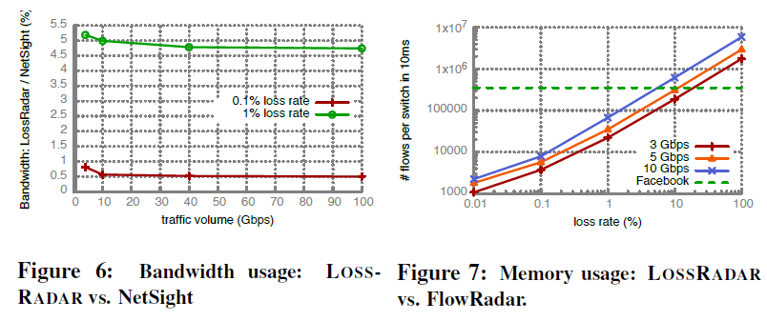
Compare with state-of-the-art solutions
LossRadar vs. full mirroring
0.5% bandwidth compared to NetSight with batch compression
LossRadar vs. per-flow counter
1.4% memory compared to FlowRadar
Notes:
We test them with a single pair of switches with traffics of different loads and different loss rates. We use simulation to test up to 100G traffic load.
In the area above the curves LOSSRADAR uses less memory; below the curves FlowRadar uses less memory

Slide 34
High inference accuracy across all types
- The precision is close to 100%， which means there is no false alarm.
- Every injected problem is captured.
We correctly classify 90.3% of the random drops and 73.1% of the blackhole losses.
- The missed blackhole losses are all short bursts (e.g. 5 losses) of consecutive losses, so they are classified as congestion losses.
The missed random drops have two types:
A small number of random drops happen closely (e.g. 3 random drops with gaps less than 10 ms), so they are classified as congestion losses;
during some intervals, there are other losses being classified as unknown together with random drops, so the distribution is uneven, and we classify all the losses in these intervals as unknown.
Notes:
We correctly classify 90.3% of the random drops and 73.1% of the blackhole losses. The missed blackhole losses are all short bursts (e.g. 5 losses) of consecutive losses, so they are classified as congestion losses.
The missed random drops have two types: (1) a
small number of random drops happen closely (e.g. 3 random
drops with gaps less than 10 ms), so they are classified as
congestion losses; (2) during some intervals, there are other
losses being classified as unknown together with random
drops, so the distribution is uneven, and we classify all the
losses in these intervals as unknown.

Slide 35
Conclusion
Loss diagnosis is very important
High impact on performance
Diagnosis takes a lot of human effort
LossRadar can detect losses and diagnose root causes
Detection: details of individual losses, with locations, within 10ms
Diagnosis: correctly discover root causes
P4 code: https://github.com/liyuliang001/LossRadar-P4
Notes:
Detect time = Waiting time, transfer time and decoding time

